Slide 1
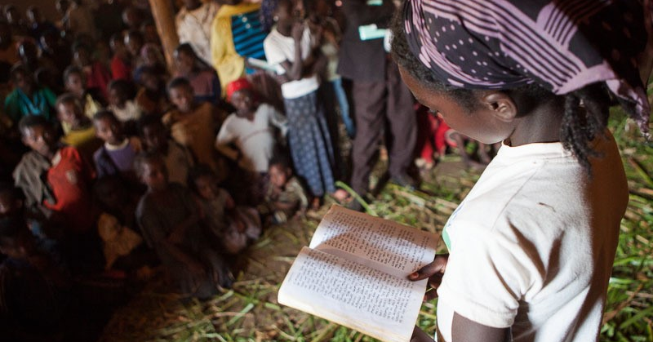
Oral or Written Translation

Slide 2
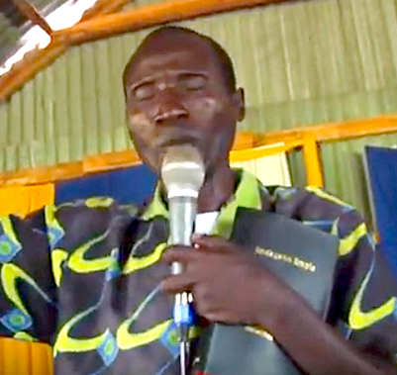

Oral vs. Literate Culture
Oral
Literate
Think in images
Greater retention of information
Oral messages are important
Think in pictures/words
Less retention of information
Written messages are important

Slide 3
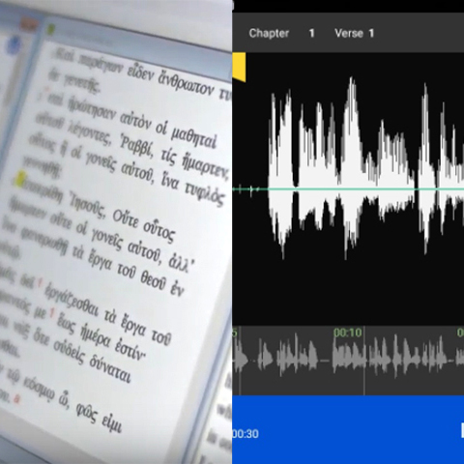
Which Translation is Better: Oral or Written?
If there is no written script:
oral is best
OR
write a script and record an audio
If the translators are literate:
write a script and record an audio

Slide 4

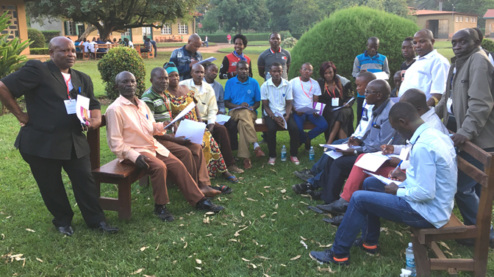
Who Decides?
Local Church
How many people read?
Do they prefer listening to reading?
Which would be more acceptable as Scripture?

Slide 5
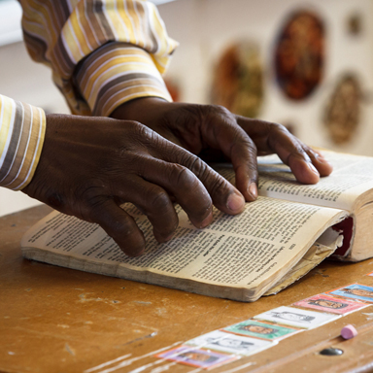
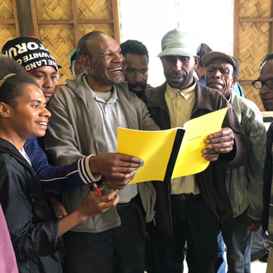
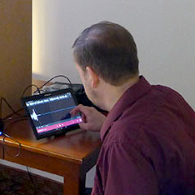
Oral Translation Preference
Are they literate in gateway language?
Literate:
source text & resources are accessible
Illiterate:
someone can read the text out loud
Some GLs have audio recordings

Slide 6


